Slide 1
Image Segmentation

Slide 2
Image Segmentation
Image segmentation is the operation of partitioning an
image into a collection of connected sets of pixels.
1. into regions, which usually cover the image
2. into linear structures, such as
- line segments
- curve segments
3. into 2D shapes, such as
- circles
- ellipses
- ribbons (long, symmetric regions)

Slide 3
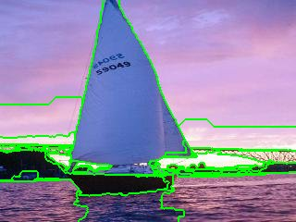
Example 1: Regions

Slide 4
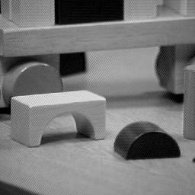
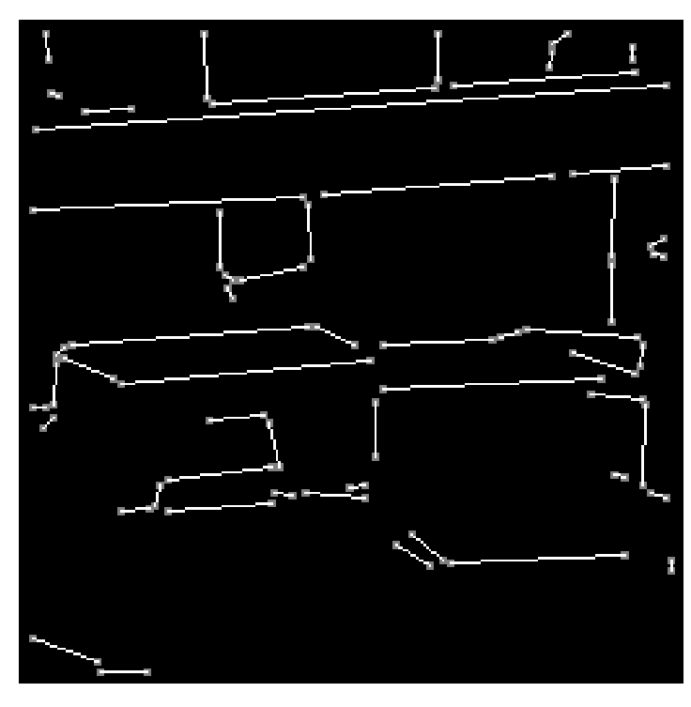
Example 2: Straight Lines

Slide 5
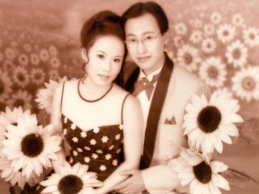
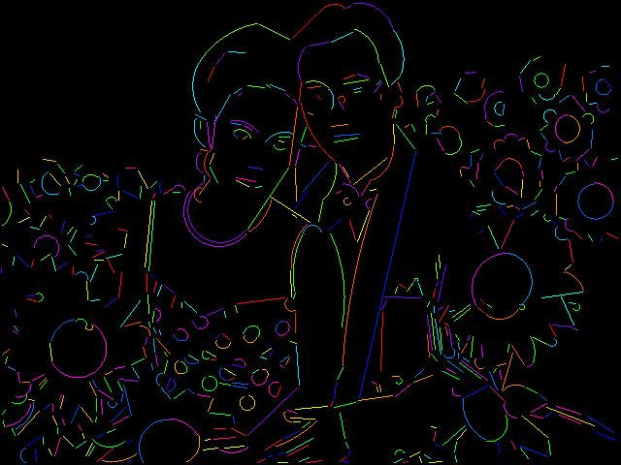
Example 3: Lines and Circular Arcs

Slide 6
Region Segmentation: Segmentation Criteria
A segmentation is a partition of an image I into
a set of regions S satisfying:
1. ∪ Si = S Partition covers the whole image.
2. Si ∩ Sj = φ, i ≠ j No regions intersect.
3. ∀ Si, P(Si) = true Homogeneity predicate is
satisfied by each region.
4. P(Si ∪ Sj) = false, Union of adjacent regions
i ≠ j, Si adjacent Sj does not satisfy it.

Slide 7
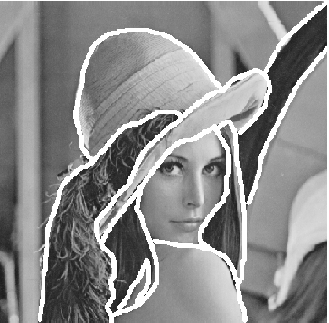

Introduction
Three major ways to do.
Thresholding
Edge-based segmentation
Region-based segmentation

Slide 8
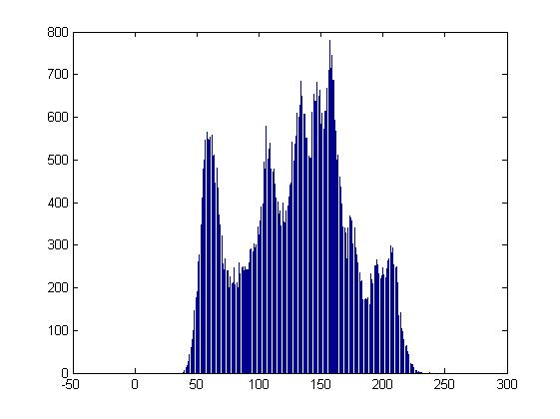
Thresholding
Finding histogram of gray level intensity.
Basic Global Thresholding
Otsu’s Method
Multiple Threshold
Variable Thresholding

Slide 9
Region Growing
Region growing techniques start with one pixel of a
potential region and try to grow it by adding adjacent
pixels till the pixels being compared are too disimilar.
The first pixel selected can be just the first unlabeled
pixel in the image or a set of seed pixels can be chosen
from the image.
Usually a statistical test is used to decide which pixels
can be added to a region.

Slide 10
Edge-based segmentation
Using mask to detect edge in image by convolution.
Basic Edge Detection
The Marr-Hildreth edge detector(LoG)
Short response Hilbert transform(SRHLT)
Watersheds

Slide 11
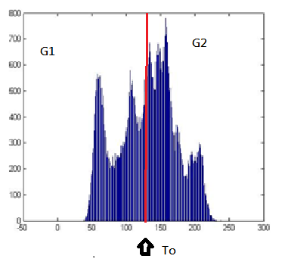
Thresholding Basic Global Thresholding
Select an initial To
Segment image use:
Compute the average intensity
and for the pixels in and .
Compute a new threshold:
Until the difference between values of T is smaller than a predefined parameter.

Slide 12
Otsu’s Thresholding
Potimum thresholding
Maximize between class variance

Slide 13
Otsu’s Method
{0,1,2,…,L-1} , L means gray level intensity
M*N is the total number of pixel.
denote the number of pixels with intensity
we select a threshold , and use it to
classify : intensity in the range and :
,
,
, it is global variance.
Notes:
Optimum Global Thresholding, viewed as a statistical-decision

Slide 14
it is between-class variance
it is a measure of separability between class.
For x = 0,1,2,…,M-1 and y = 0,1,2…,N-1.
Using image Smoothing/Edge to improve Global Threshold
Notes:
Smoothing can make intensity more smooth , on the other way the edge detection can make intensity more clear

Slide 15
To get the best K try for all values of K and compute the between class variance,
Select the K with maximum between class variance
subject to the constraint 0<P(k)<1

Slide 16
Multiple Threshold
As Otsu’s method, it takes more area and k*
Disadvantage: it becomes too complicate when number of area more than three.

Slide 17
Variable thresholding
Noise and illumination variation
Smoothing – frequently using is tedious

Slide 18

Variable Thresholding
Image partitioning – rectangles (constant illumination)
.
It is work when the objects of interest and the background occupy regions of reasonably comparable size. If not , it will fail.
Notes:
It is to subdivide an image into nonoverlapping rectangles

Slide 19
Variable thresholding based on local image properties
Let and denote the standard deviation and mean value of the set of pixels contained in a neighborhood, .
Txy = a + b
Notes:
這地方為一直掃下來，並算周圍的平均及標準差，再去做分割
3)為一個special case

Slide 20
Using moving average
It discussed is based on computing a moving average along scan lines of an image.
denote the intensity of the point at step k+1.
n denote the number of point used in the average.
is the initial value.
,where b is constant and is the moving average at point (x,y)

Slide 21

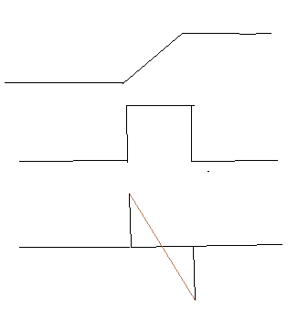
Edge-based segmentation Basic Edge Detection
Why we can find edge by difference?
image
intensity
first-order deviation
second-order deviation
First-order deviation | produce thicker edges
Second-order deviation | stronger response to fine detail | double-edge response | Determine edge is from light to dark or dark to light
Notes:
介紹一階及二階微分

Slide 22
Gradient
The image gradient is to find edge strength and direction at location (x,y) of image.
The magnitude (length) of vector , denoted as M(x,y):
The direction of the gradient vector is given by the angle:

Slide 23
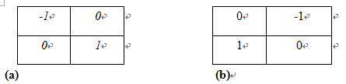
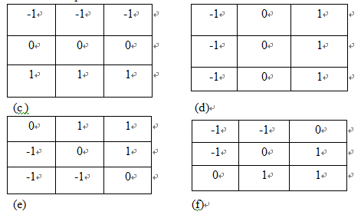
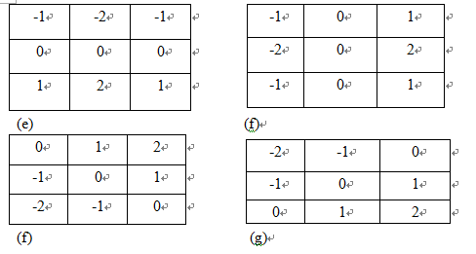
Roberts cross-gradient operators:
Prewitt operator:
Sobel operator:

Slide 24
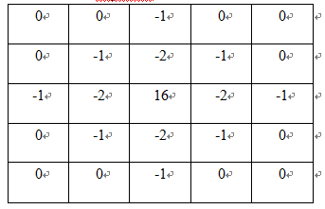
The Marr-Hildreth edge detector(LoG)
This is second-order deviation, we call Laplacian.
Filter the input image with an n*n Gaussian lowpass filter. 99.7% of the volume under a 2-D Gaussian surface lies between about the mean. So .
Notes:
For linear processing

